Slide 1
Group 27
William Springsteen, Stefan Klas, Rory Fayed & Kiran Patel

Slide 2
Emulate and Assemble Testsuite

Slide 3
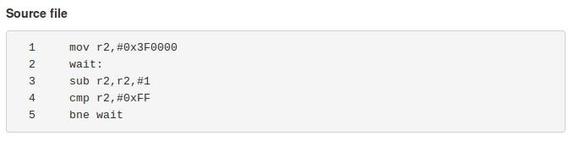
Interesting loop01 Test Case
Involves decrementing 0x3F0000 down to 0xFF in a loop
Takes a long time, so used to timeout
Had to make emulator more efficient
Now runs smoothly (Most of the time!)

Slide 4
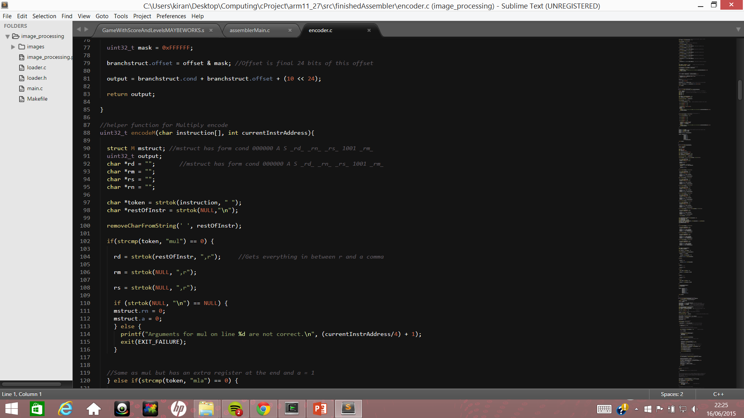
Difficulties in Emulator and Assembler
Little experience in C
Working out how to go about splitting workload
Emulator
Trying to keep to spec by using a pipeline, led to useless code
Confusion in how ldr/str worked at the start. Helped to continue on to assembler and come back
Assembler
Agreeing on how to implement lookup table
Strtok function
Notes:
Had no idea where to start with emulator because we didn’t know what we were doing.
We were experimenting with different ways of doing stuff.
Started on emulator, got stuck so moved on to assembler and then came back
Problem with strtok – in the end we just got rid of all spaces

Slide 5
Extension

Slide 6
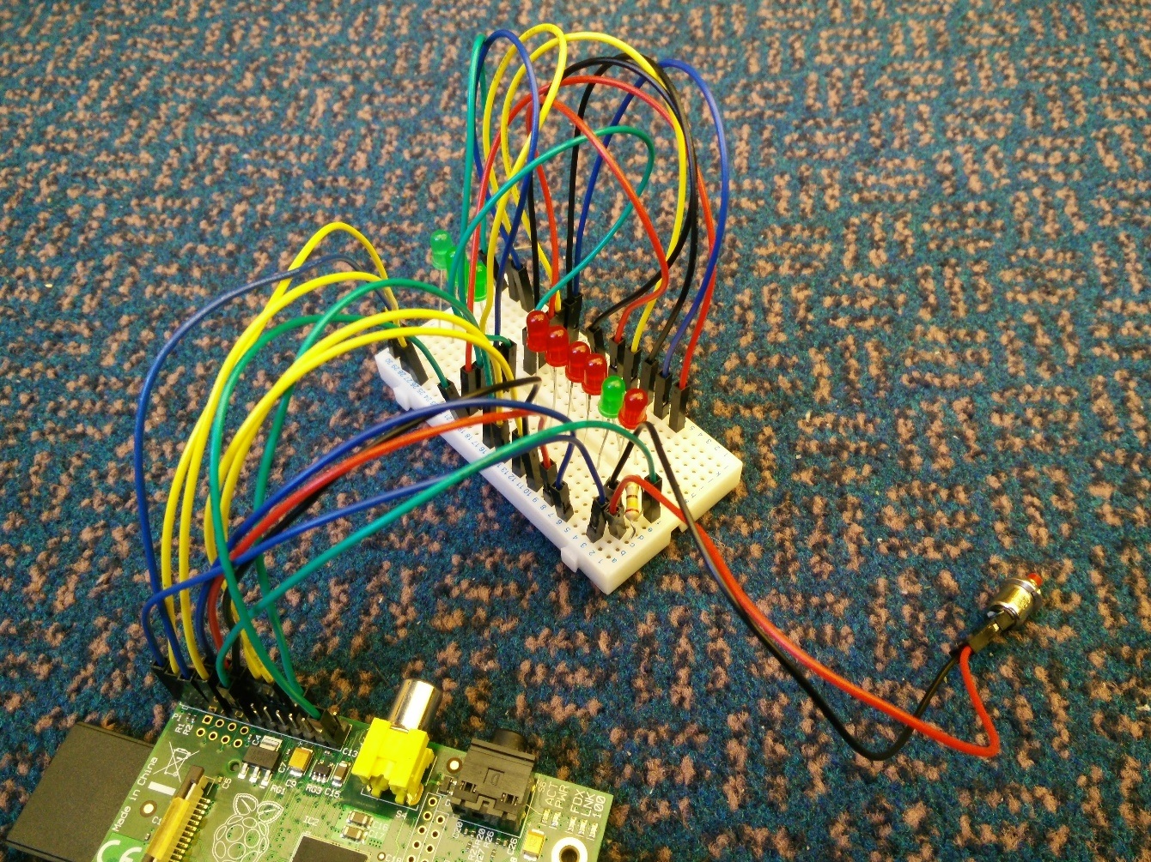
Extension Overview
Made a reaction game only using LEDs
6 LEDs (5 red, 1 green), where you have to press button on green light
3-bit LED level counter
Different difficulties as the level increases
Added comments to assembler
Did what we could with no special equipment
Notes:
EXPLAIN GAME AFTER FIRST BULLET POINT – Explain in detail how it works
Extended part 3 task
Got some LEDs and a button, and tried to think what we could do with this basic equipment
Having more levels(more LEDs in the level counter) would have meant the change in the speeds between levels would have been too subtle
Commenting helps a lot in understanding the 500 lines of code. It means we can dedicate registers like (r0 is for 0x20200000). This reduces errors in coding
HOW IT WORKS:
In the waiting loop while an LED is on it checks whether the input has been pressed(pin level register)

Slide 7
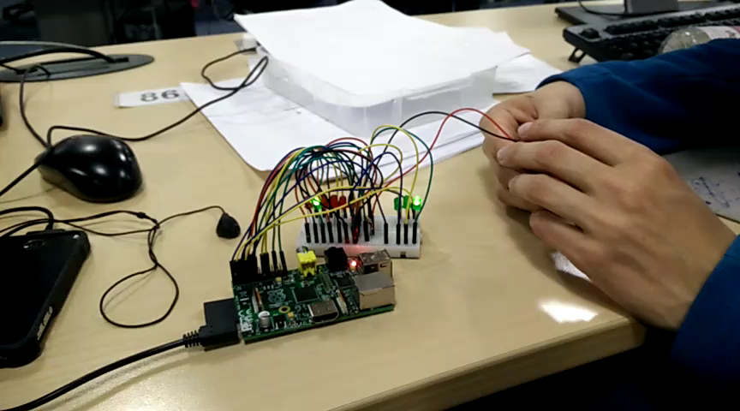
Extension Demonstration

Slide 8
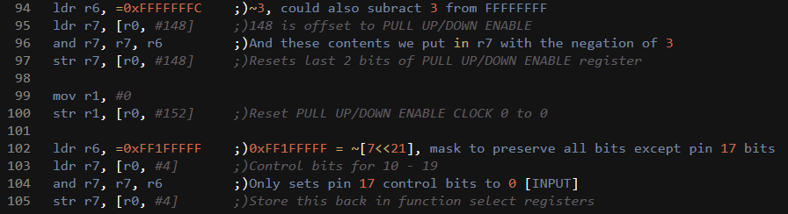
Difficulties in Extension
Most things were fairly easy
Initially figuring out how to debug
Input
Getting the speeds right (making it difficult to complete the game)
Notes:
Wanted to rather do an extension that would be easier but complete in time than an extension that was harder but may not be complete in time
LEDs flashing in a sequence
Didn’t know initially if the circuits were wrong or the code was wrong because we couldn’t debug code with debugger
I think we have the speeds right because up until now nobody has been able to complete the last level (so there is still a desire to continue playing the game)
Input was the tricky part. We looked at the source code of the python methods gpio.setup and gpio.input in order to figure out how to set it up and converted this into assembly. We set it up as pin pull down

Slide 9
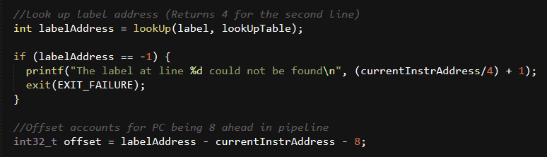
Testing and Debugging of Extension
Ran in assemble and emulate
Made them give out error messages
Added comment functionality
Started with simple assembly code, then slowly added more
Couldn’t use debugger with ARM assembly code directly, had to use debugger on assembler with ARM assembly code as argument
Notes:
First we tested the LEDs lighting up in a sequence.
Then we got the input working.
Finally we got the scoring system working and then put it all together
Commenting made it a lot easier to debug

Slide 10
Reflection

Slide 11
How We Went About The Project
Did most things together
Met in labs every weekday
Went through specification together
Notes:
Working together worked for us due to all of us being new to C. This approach though met that the rest of the team had to be updated on changes that was being more, requiring good communication. If just one person was working on the emulator and another on the assembler, the one who makes the assembler doesn’t need to know how the emulator works and vice versa.
Near the end, it made more sense to work on different parts
Dedicated being the labs every weekday
In the assembler and extension we read through the specification together . Was very helpful so that everyone understood all parts of the spec

Slide 12
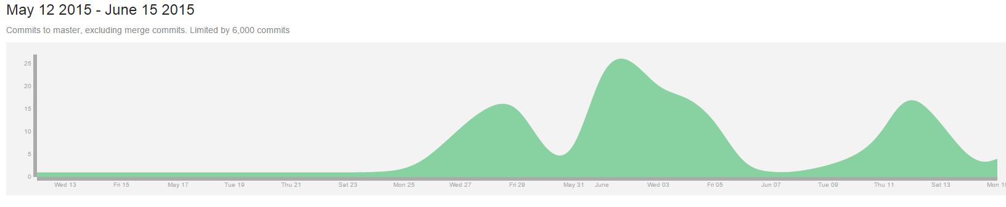
How Well We Worked As A Group
Communicated well
Great teamwork
Helped each other when stuck
All willing to meet up in labs and do our fair share of work
Notes:
Communcation using facebook – responding very quickly
Helped each other understand the spec and if one was stuck on a problem

Slide 13
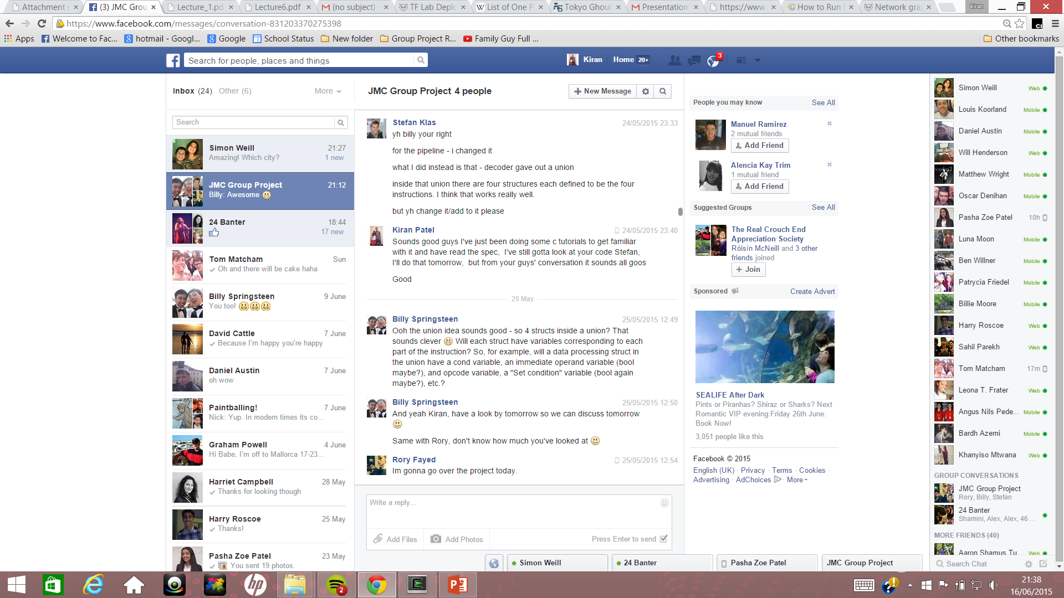
Programming in Groups
Important that everyone understands the spec
Comments are definitely necessary
Teamwork and communication
Everyone has a different idea, and you can see what idea is best
Branches are necessary
Problems occur when two people work on the same code without communicating
Debugging is easier in groups, as 4 people are more likely to find a bug than 1 person
Notes:
Discussion of ideas is very useful.
Why are branches necessary??

Slide 14
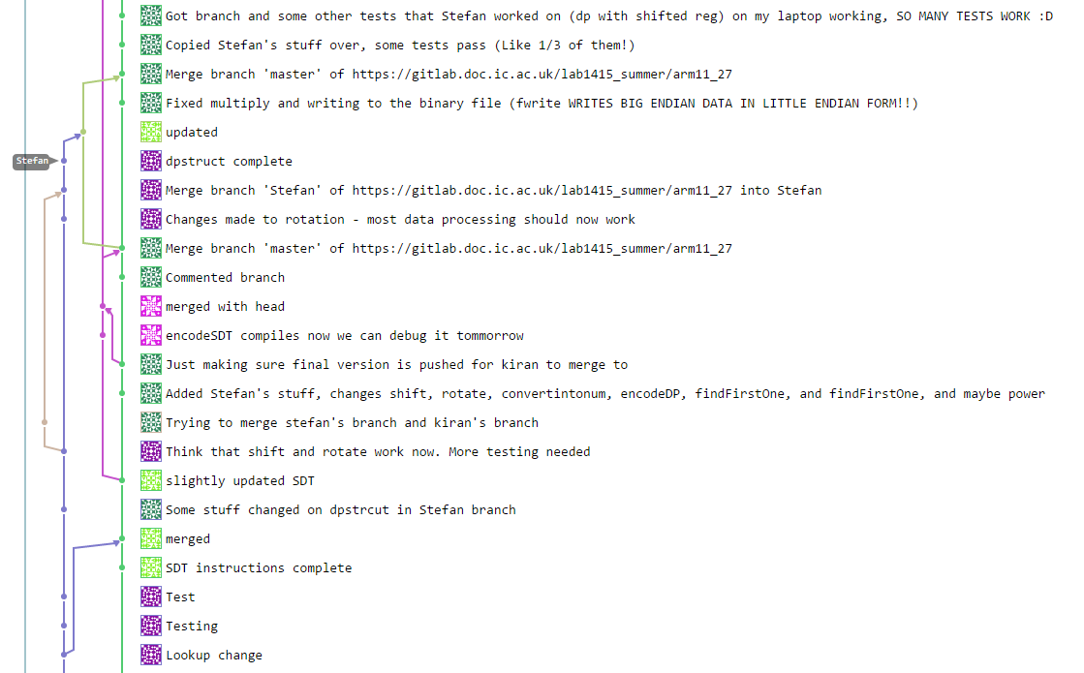
What We Would Do Differently in Future Group Programming
Put comments everywhere – especially what each method returns
Use branches a bit better
Use a scheduler
Notes:
Important that anyone can easily understand what the function does
Better use of branches where everyone first pushing to their own branch
Scheduler may be useful to assign people to particular tasks and help the team meet deadlines

Slide 15
What We Would Do The Same in Future Group Programming
Pretty much do everything the same
Lots of communication
Dedication to meeting every day to do the work and discuss ideas
Make sure everybody understands what they have to do, by going through specification together and talking to each other

Slide 16

Thanks For Listening!

